Slide 1
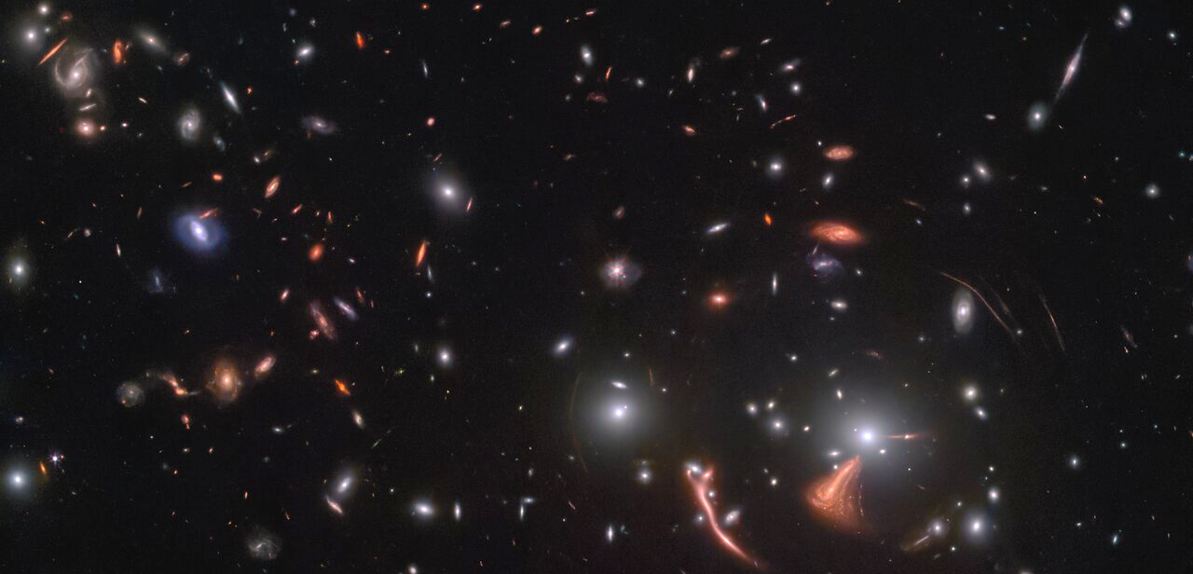

Gravitational Lensing
Maximilian von Wietersheim-Kramsta
Postdoctoral Researcher

Slide 2
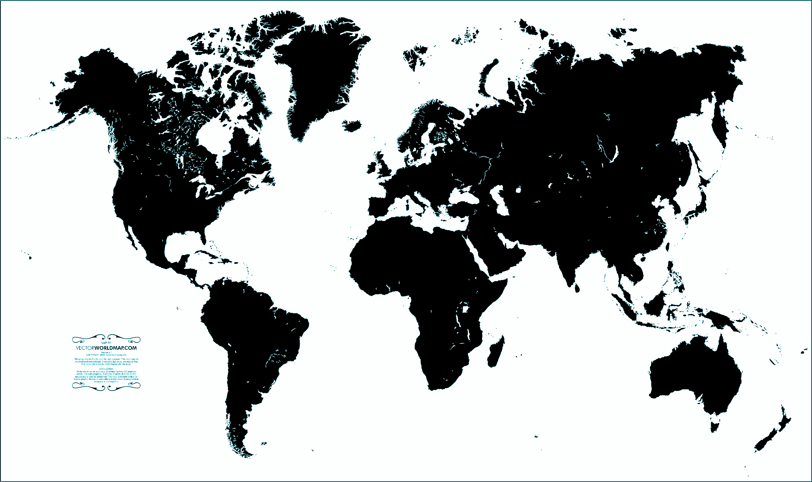



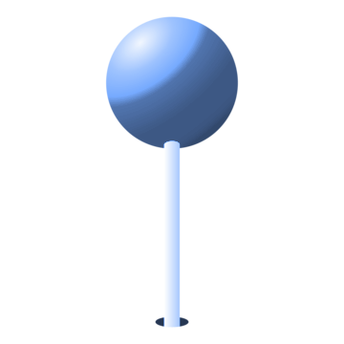
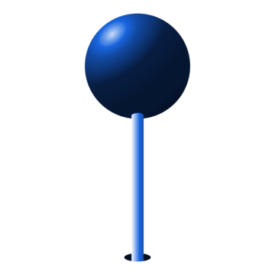
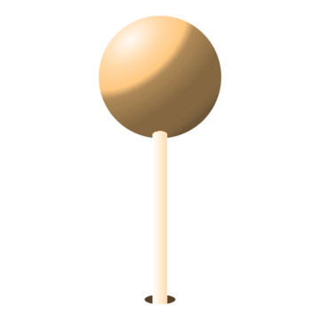
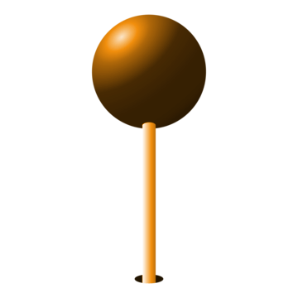
My Background
2015-2019: MSci in Physics - Imperial
2019-2023: PhD in Physics and Astronomy - UCL
2023-2024: Postdoc - UCL
2024-Now: Postdoc - Durham
CA
DE
ES

Slide 3
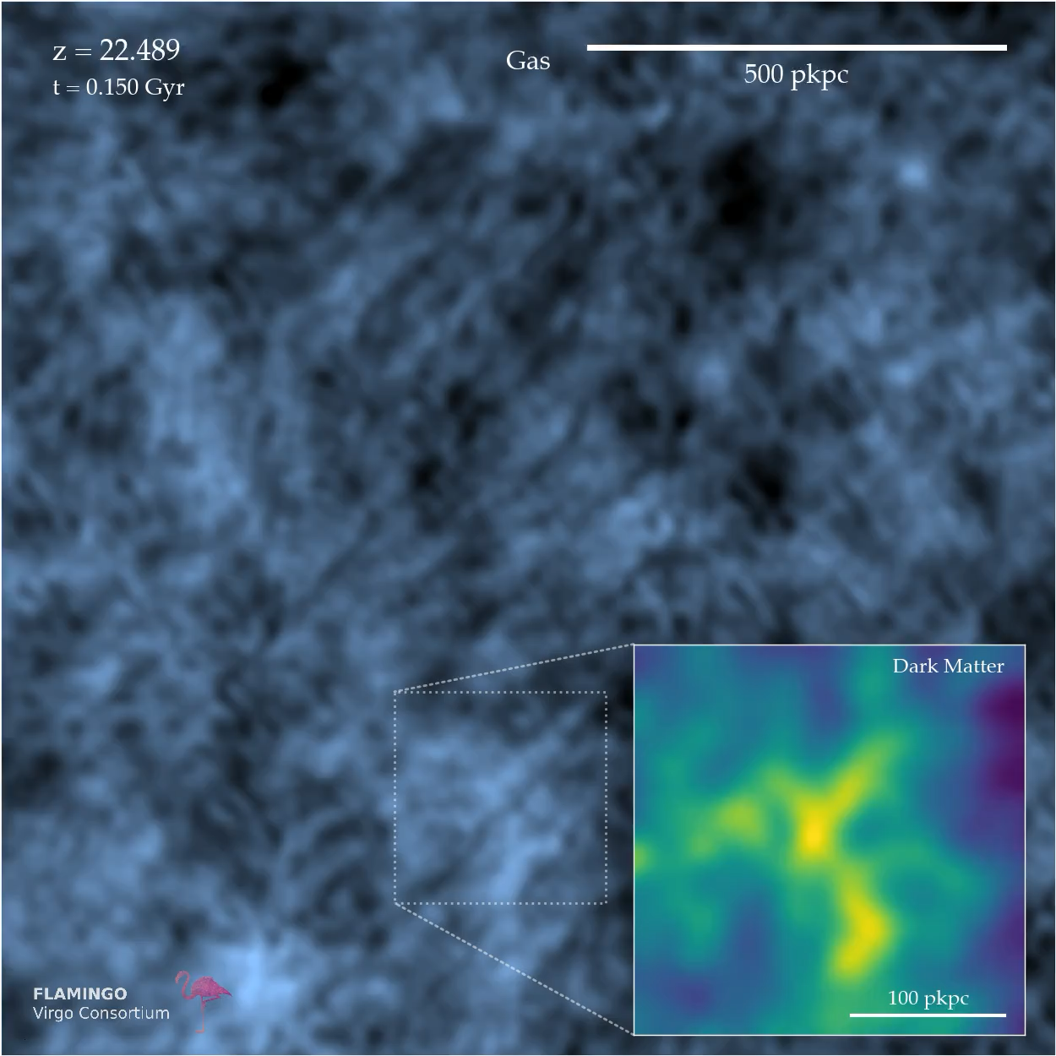
My Research:
Cosmology,
Gravity
& Dark Matter
Structure formation at the cosmological scales

Slide 4
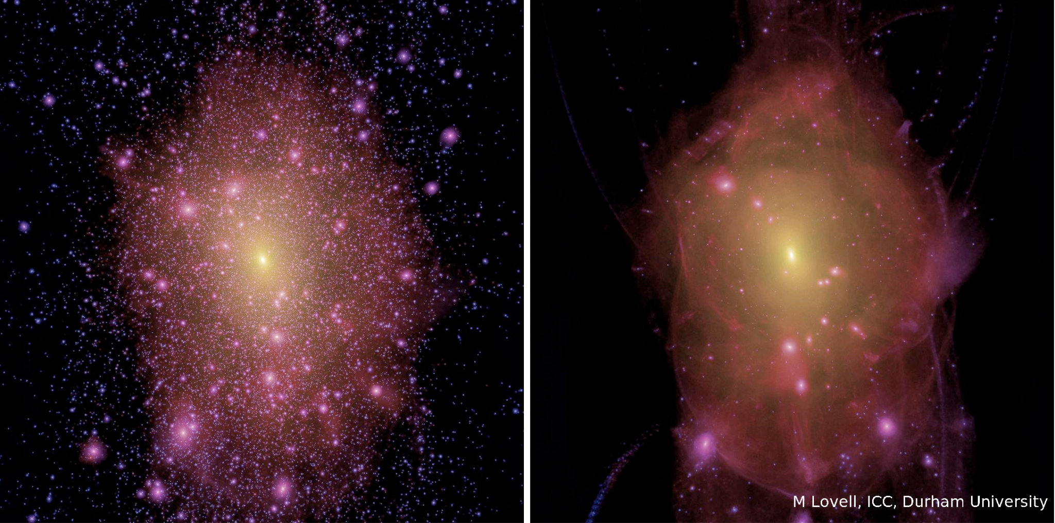
My Research: Cosmology, Gravity & Dark Matter
Structure formation at galactic scales (substructure)
Cold Dark Matter
Warm Dark Matter

Slide 5
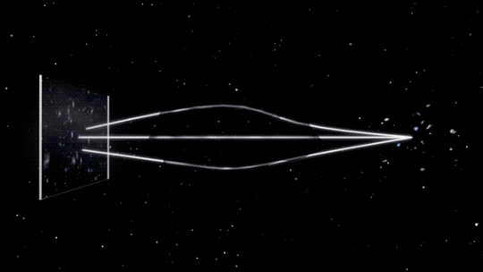
How do you see invisible matter?
Gravitational Lensing!
Credit: NASA

Slide 6
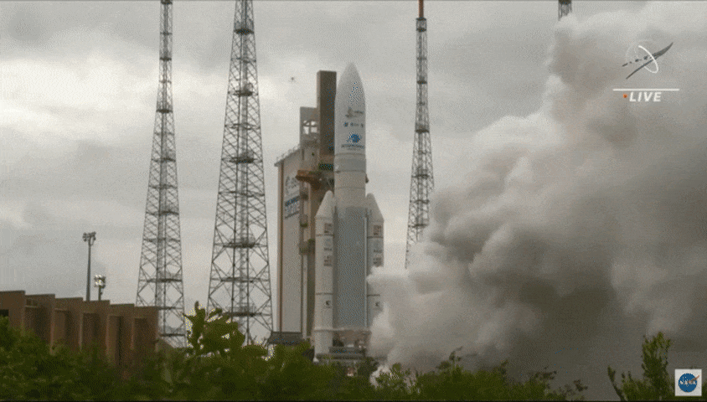
Seeing the Universe through the Gravitational Lens

Slide 7
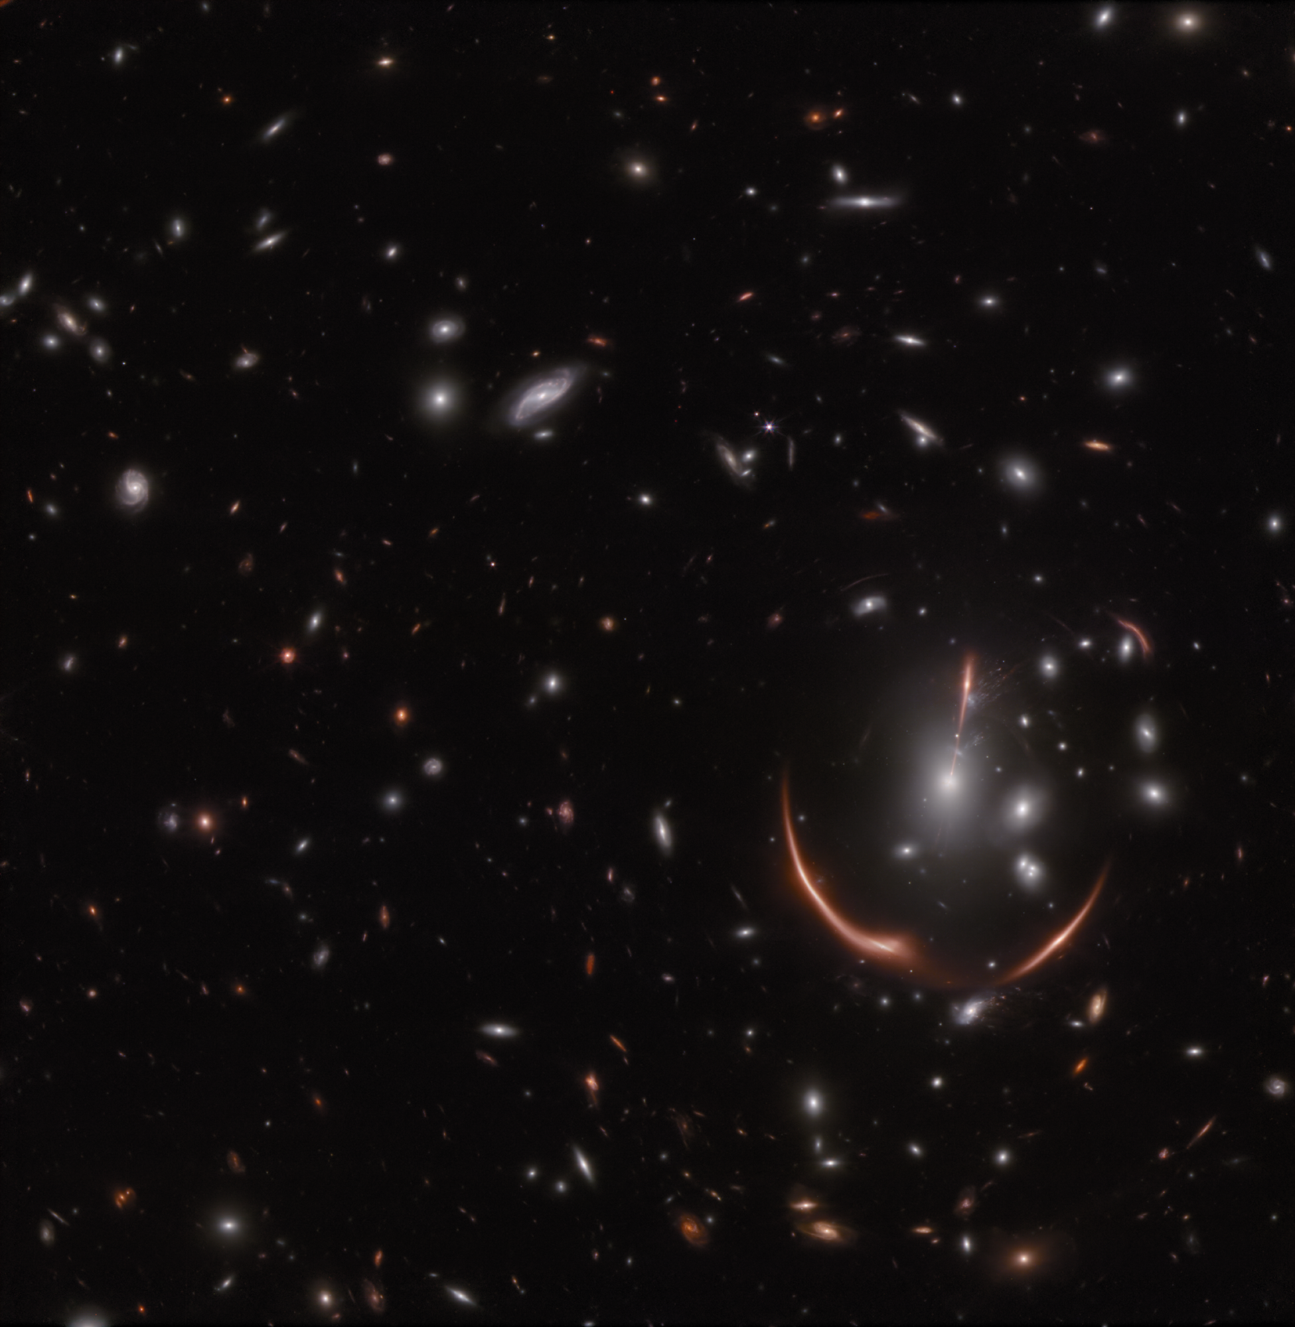
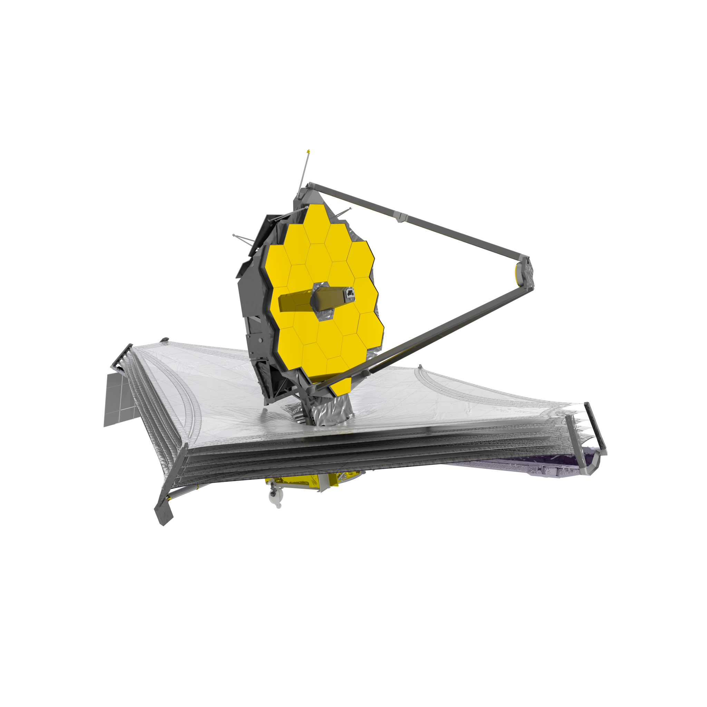

Seeing the Universe through the Gravitational Lens
NASA/ESA/CSA James Webb Space Telescope
Credit: NASA, ESA, CSA, STScI, Justin Pierel (STScI), Drew Newman (CIS)

Slide 8
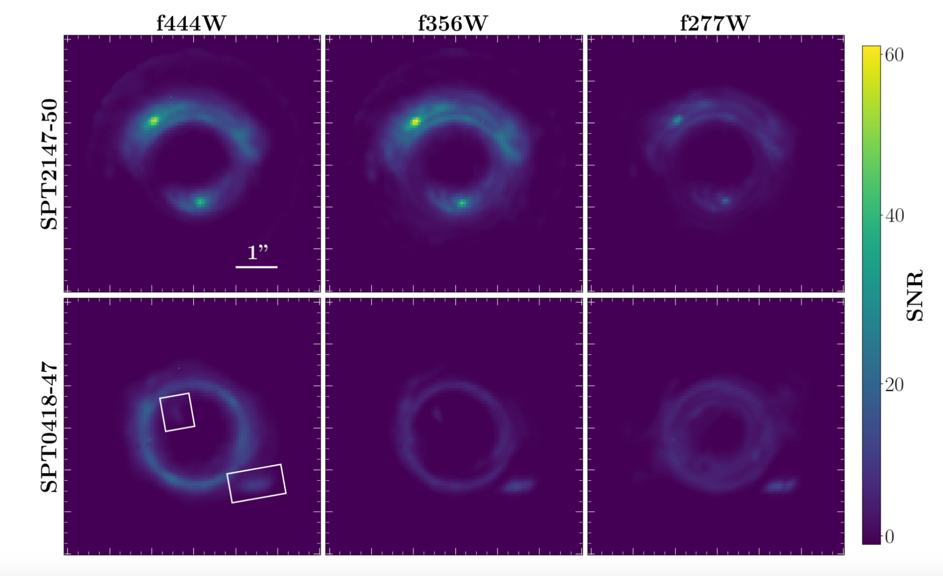
Substructure Search with JWST
Lange et al. 2024

Slide 9
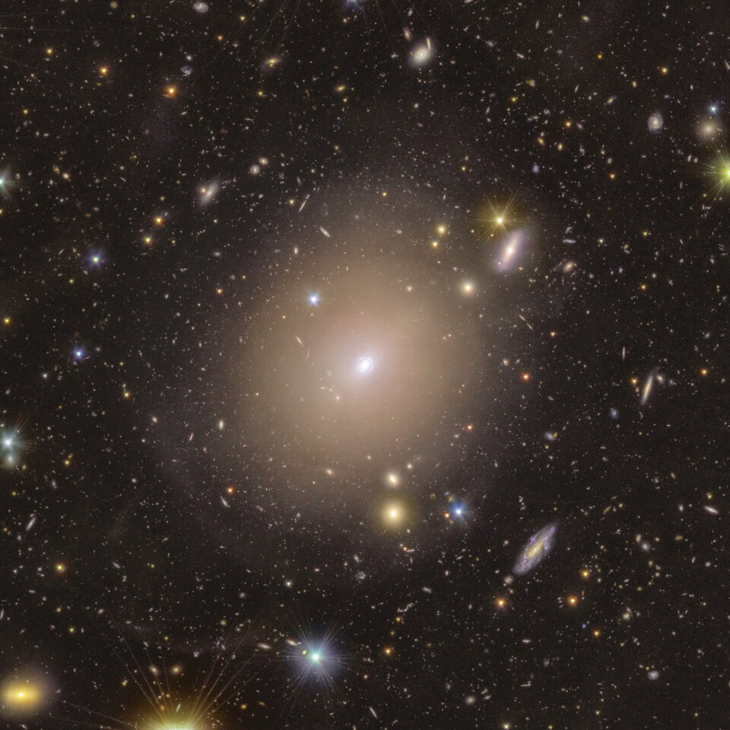
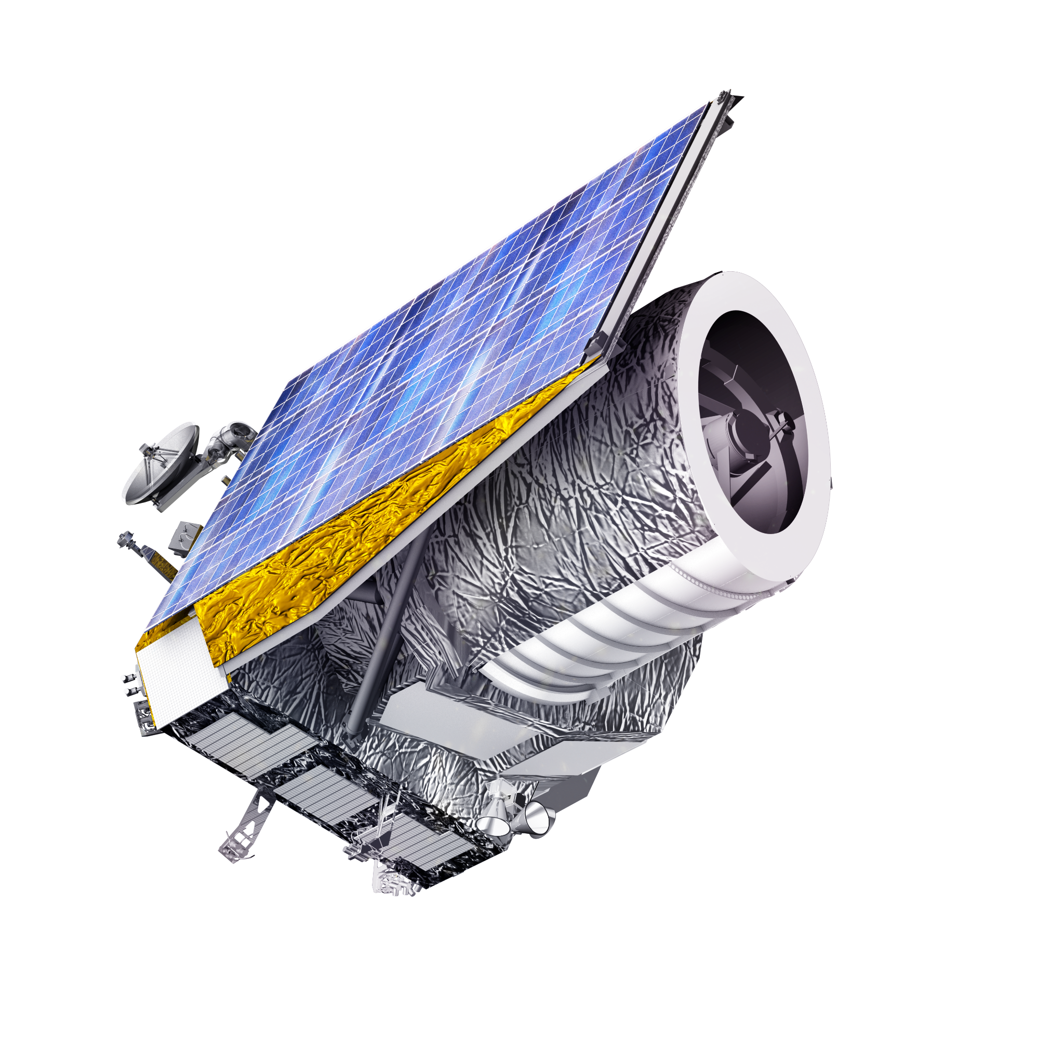
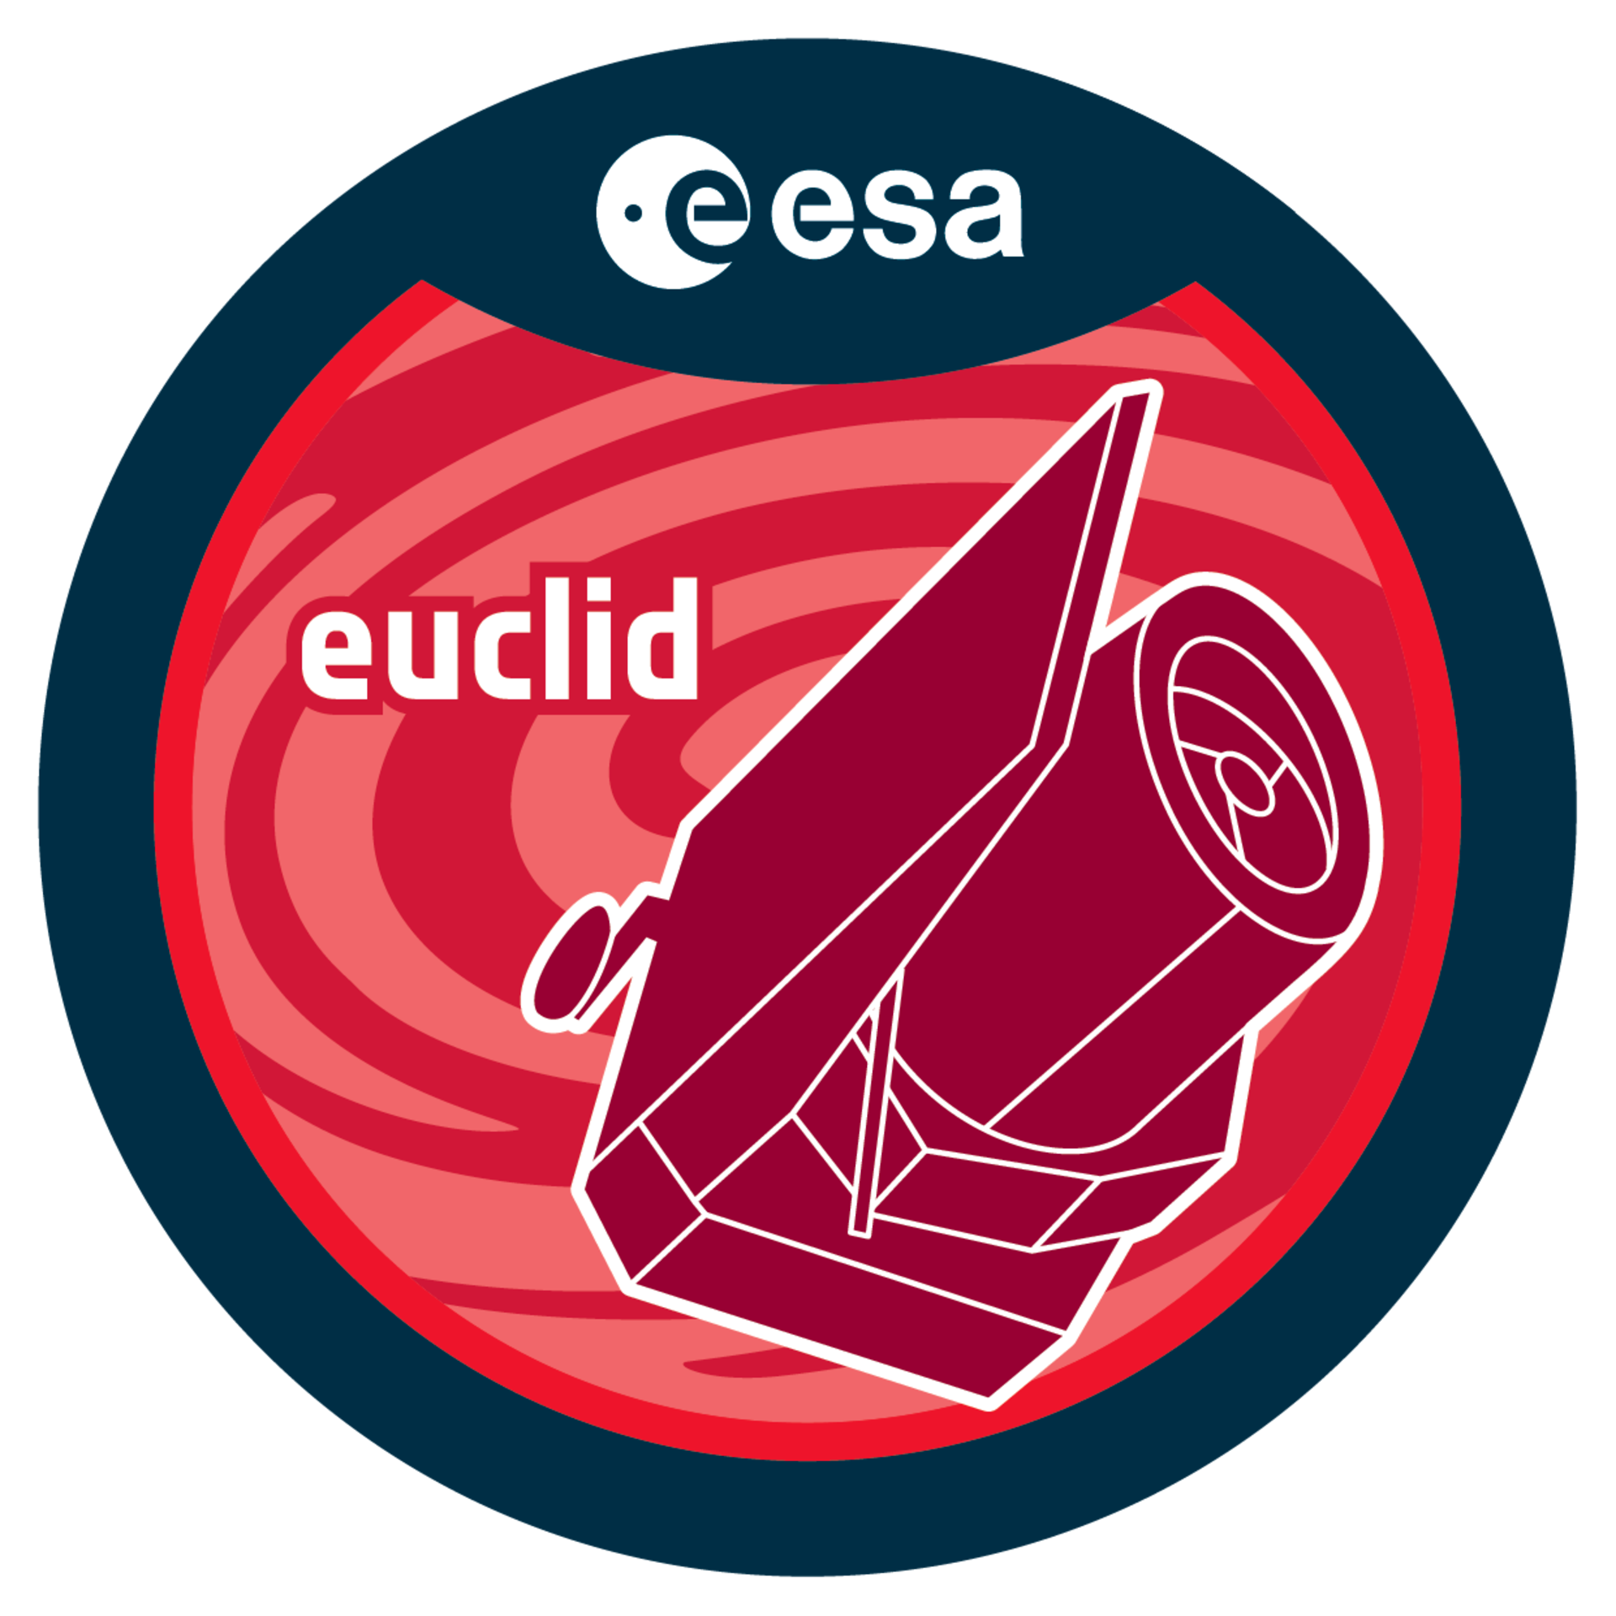
Seeing the Universe through the Gravitational Lens
ESA Euclid Space Telescope
O’Riordan et al. 2025

Slide 10
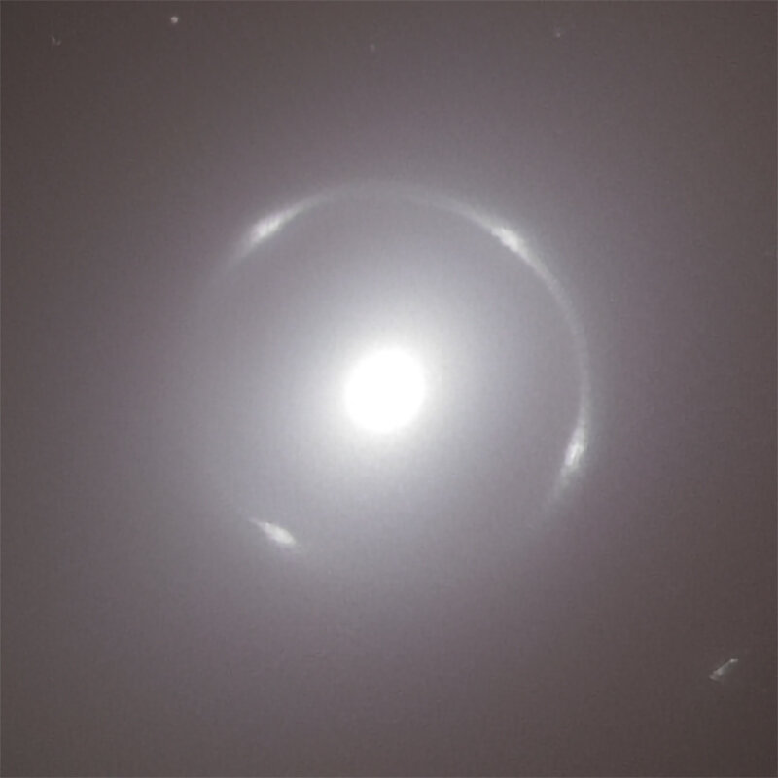
Seeing the Universe through the Gravitational Lens
ESA Euclid Space Telescope
O’Riordan et al. 2025

Slide 11
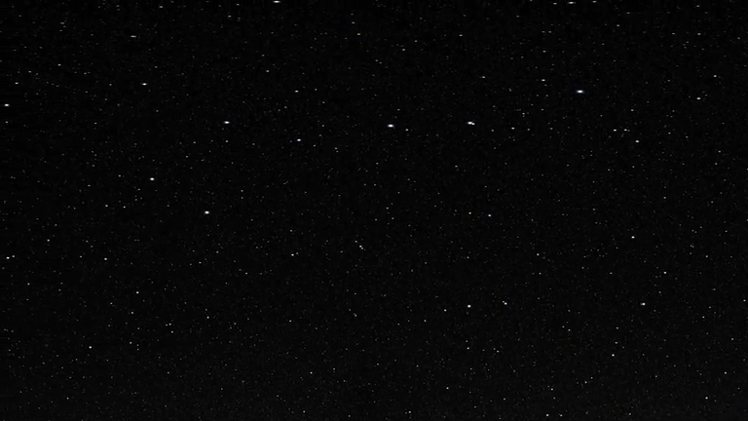
Seeing the Universe through the Gravitational Lens
Euclid will observe:
The entire extragalactic sky
2 billion galaxies (1.9 billion more than previously known)
200,000 galaxy-scale strong lensing systems (currently only know ~1000)

Slide 12
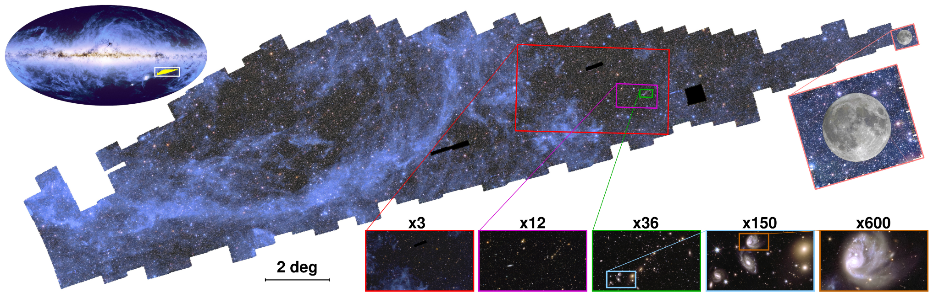
Seeing the Universe through the Gravitational Lens

Slide 13
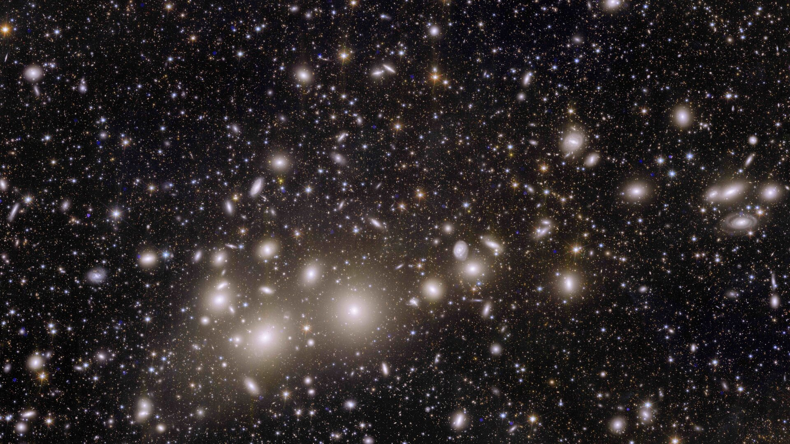

Slide 14
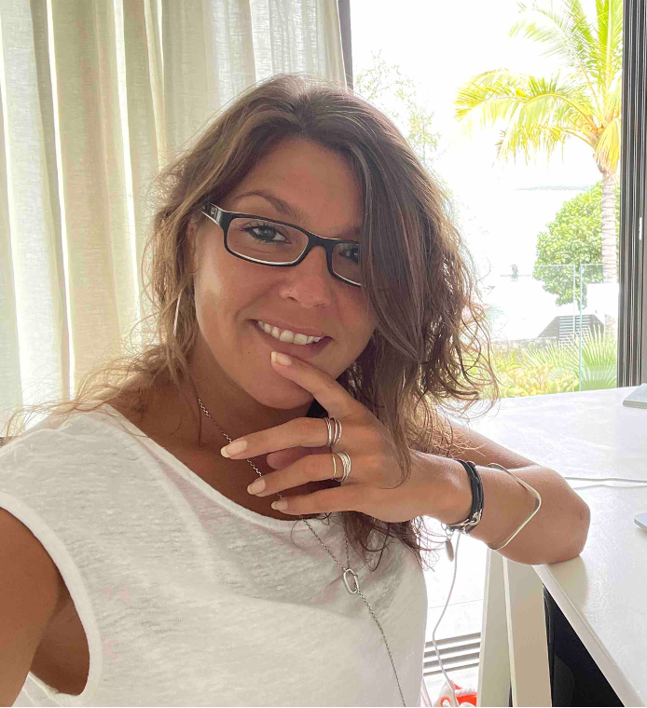
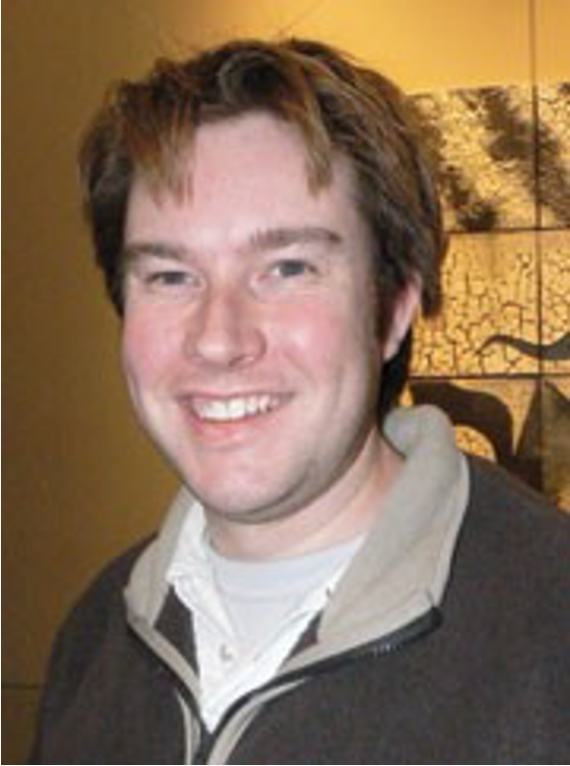
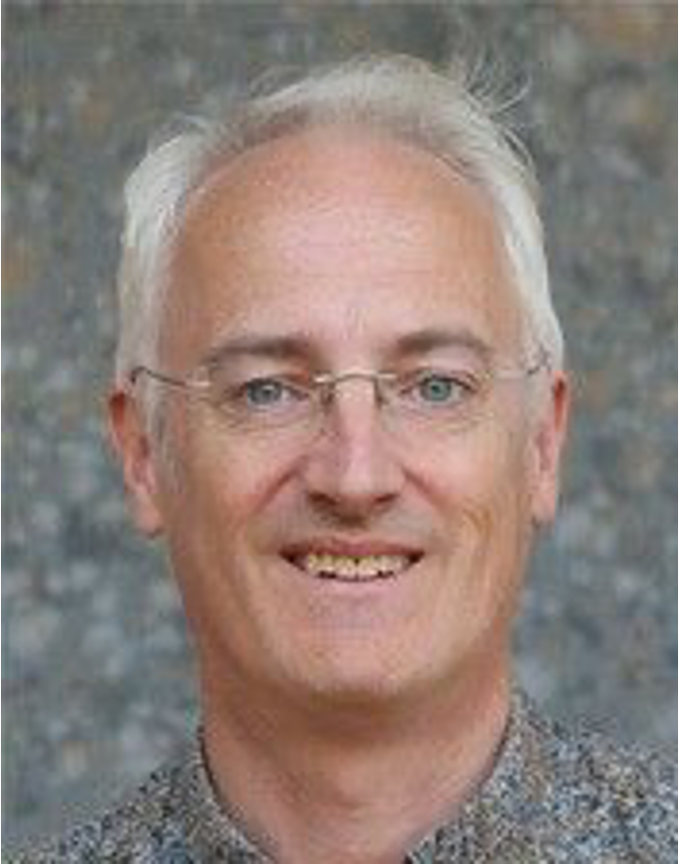
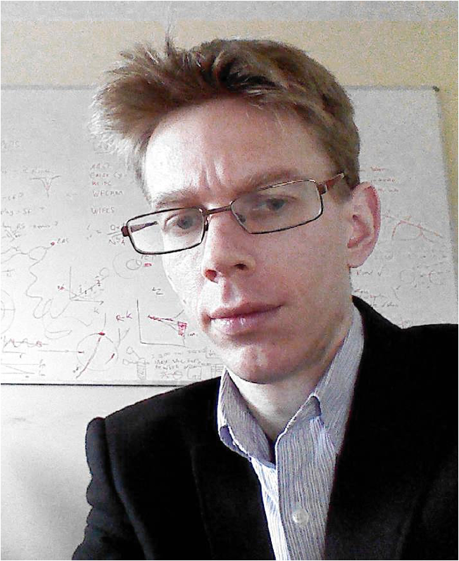
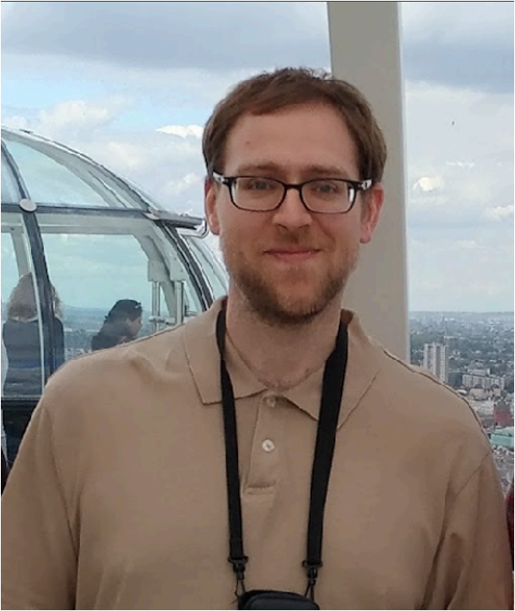
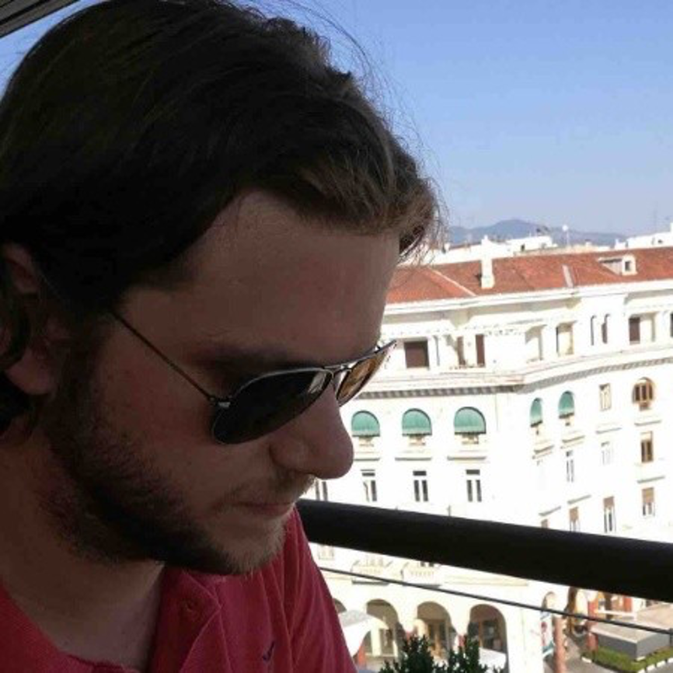
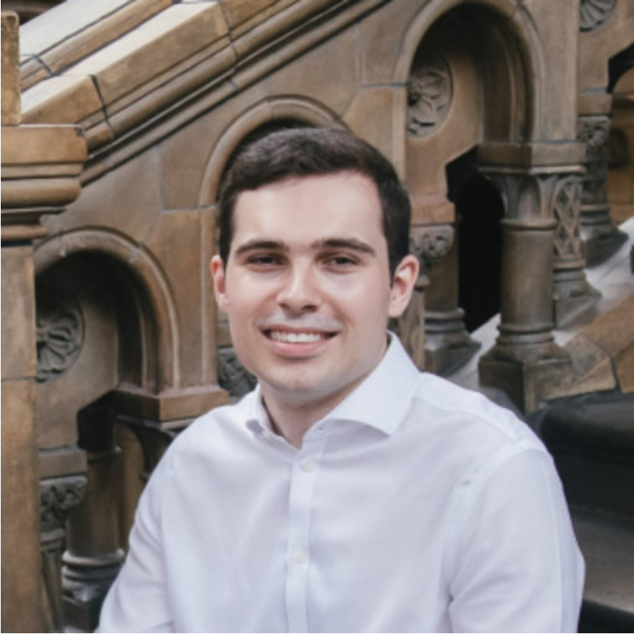
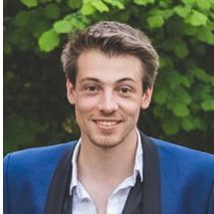
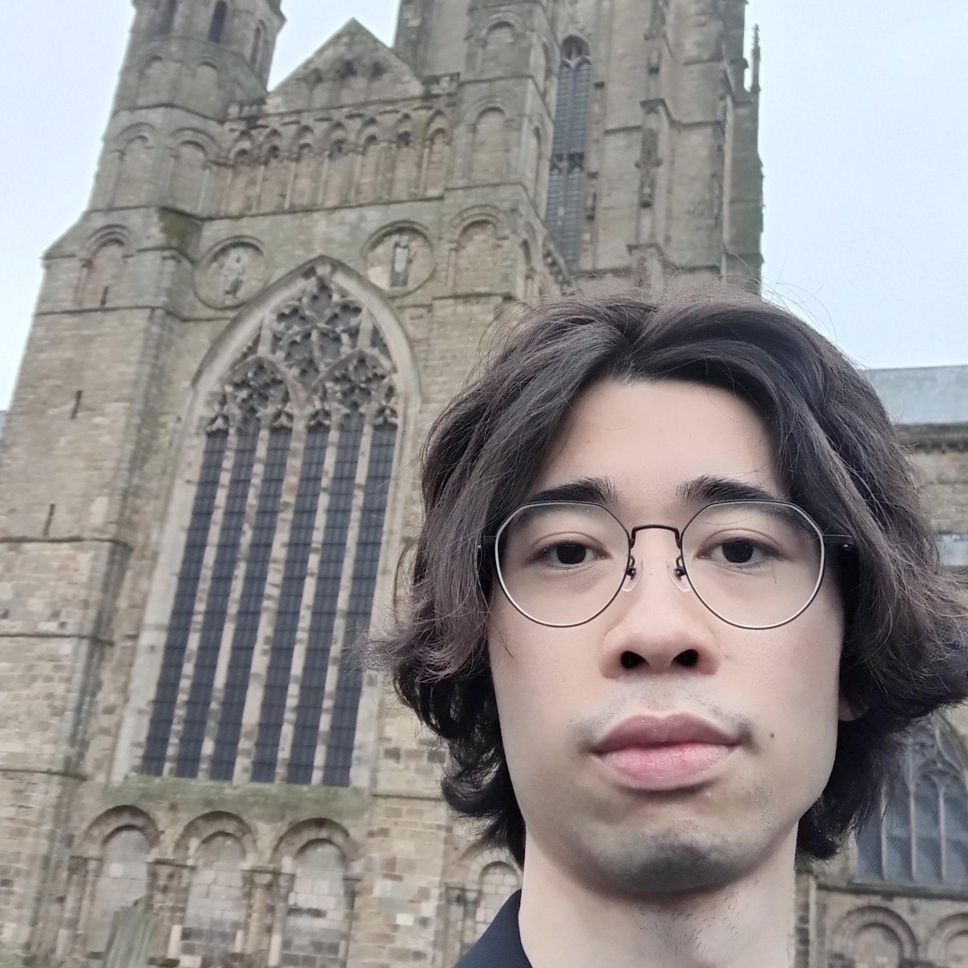
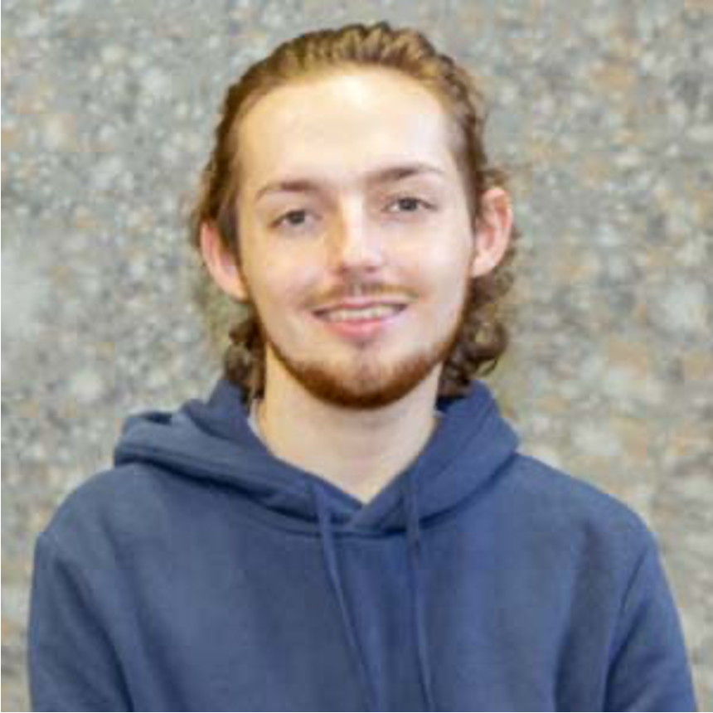
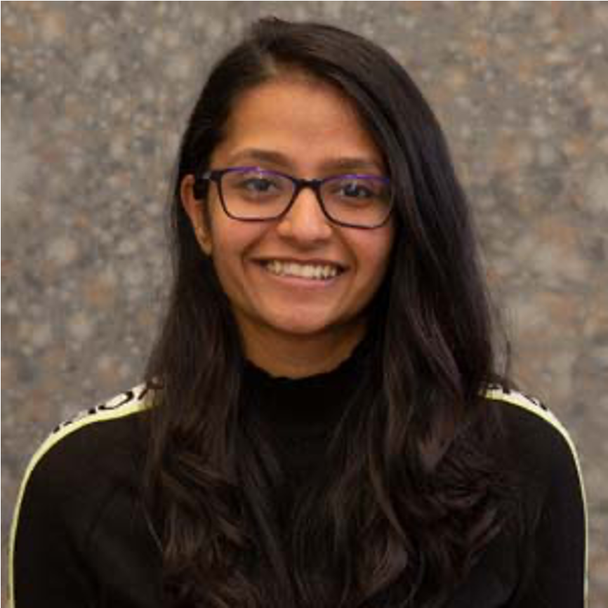
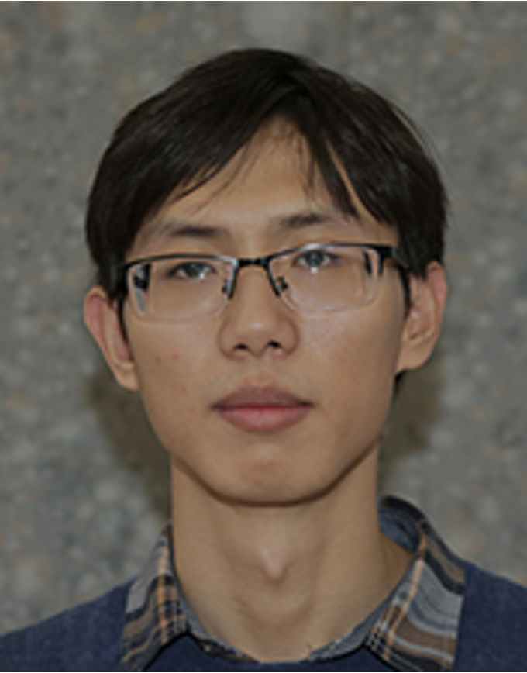
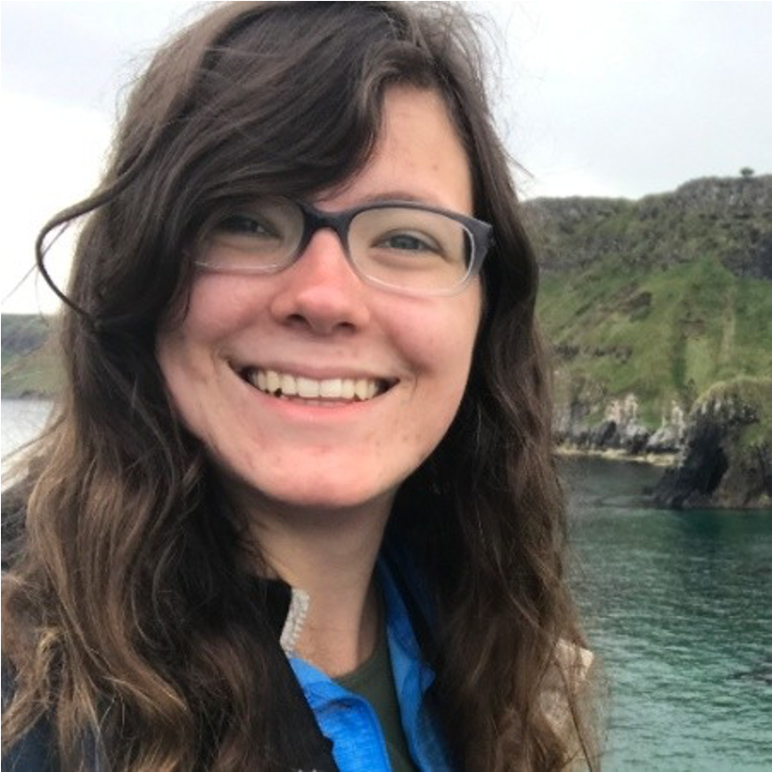
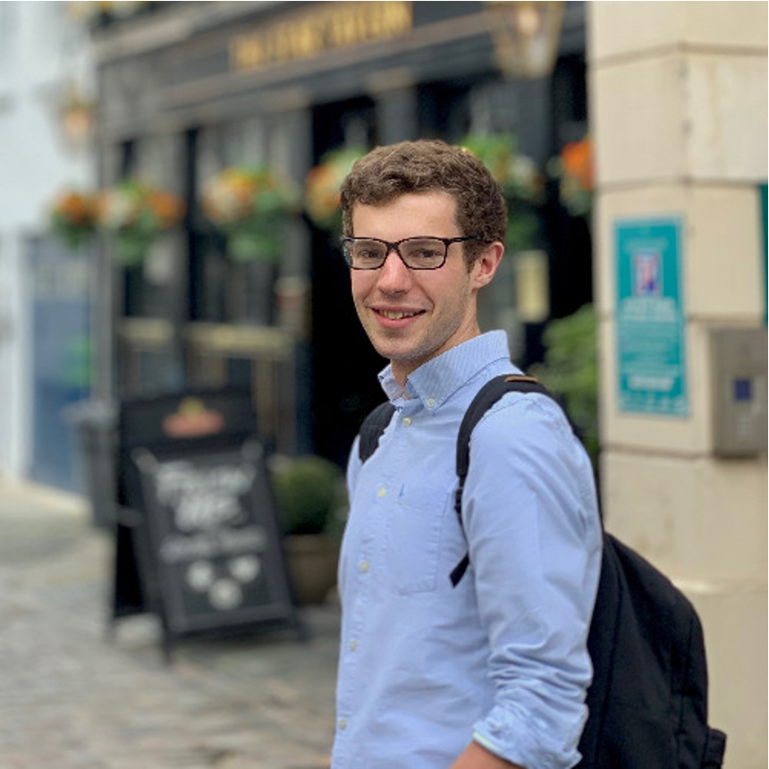
Meet your local lensers!
Mathilde Jauzac
Richard Massey
David Lagattuta
Aris Amvrosiadis
Alaistair Edge
Russel Smith
Leo Fung
Max von Wietersheim-Kramsta
Gavin Leroy
Sam Lange
Nency Patel
Catherine Cerny
Marcus Halson
Qiuhan He

Slide 15
